Slide 1
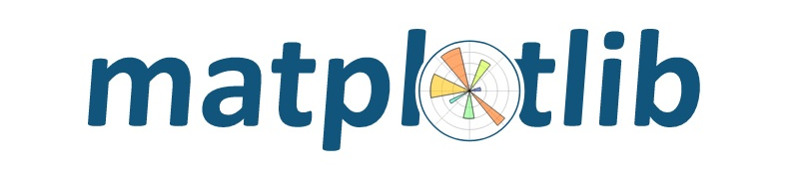





Specialization: Supervised Learning
Business Focus: HR Consulting and Outsourcing
Tool: Pandas, Matplotlib, Seaborn, Sklearn, imbalanced-learn.
Case Study: Predicting Employee Attrition for Global Talent Solutions
Project Learning Opportunities
Business Problem Understanding
Data Preprocessing and Cleaning
Addressing Class Imbalance
Model Development and Evaluation
Interpreting Model Results
AutoML Techniques
Tools and Technology to be Used

Slide 2


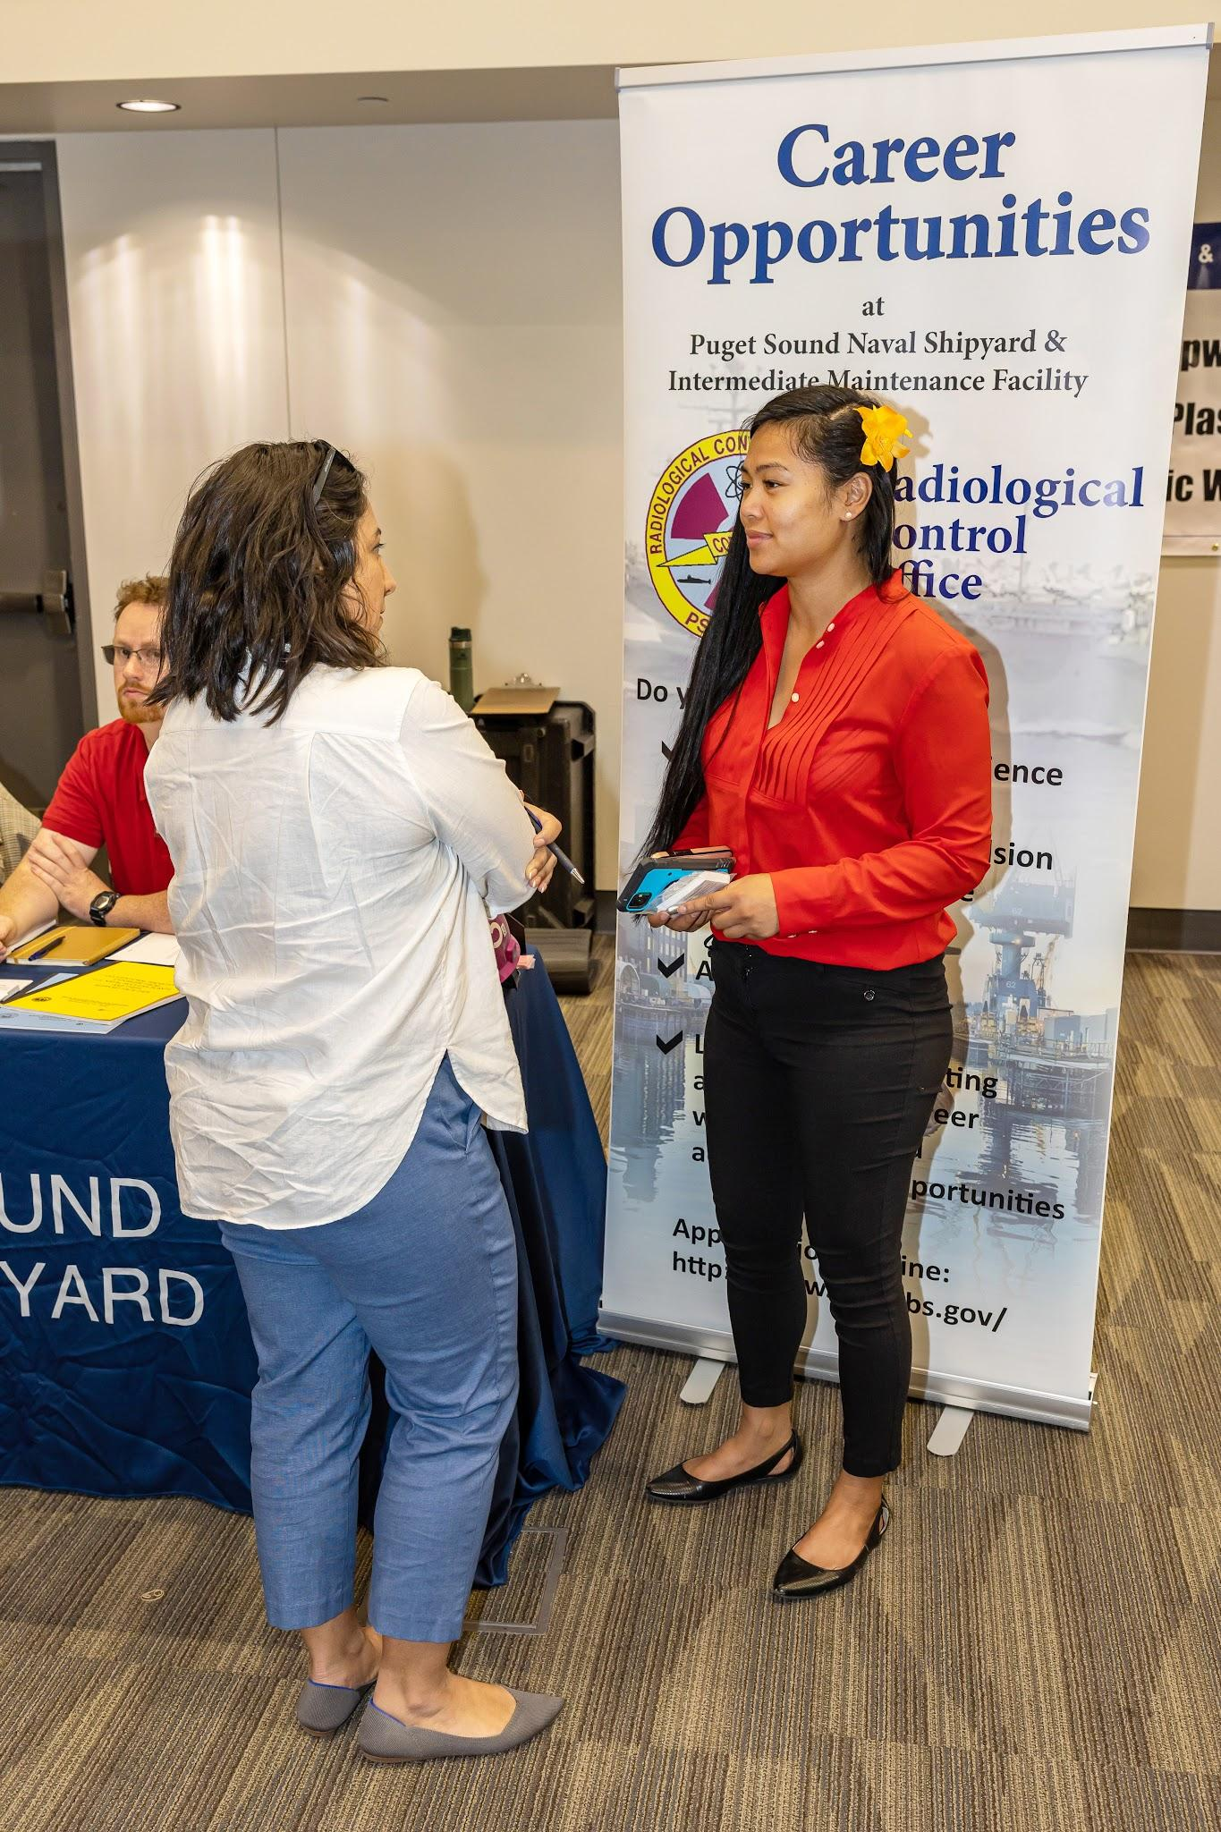

Background
Global Talent Solutions (GTS) is a multinational company specializing in providing comprehensive HR solutions, including talent acquisition, employee training, and workforce analytics.
With over 10,000 employees spread across 25 countries, GTS serves a diverse clientele ranging from Fortune 500 companies to small and medium enterprises.
GTS prides itself on fostering workplace innovation and leveraging data-driven insights to support its clients' HR strategies.
Mission: To empower businesses through innovative and data-driven human resource solutions.
Vision: To be the global leader in human capital management, transforming workplace cultures through analytics and empathy.

Slide 3

Problem Statement
GTS has noticed an alarming trend of employee turnover within its own workforce.
Over the past year, the company recorded a 20% attrition rate, significantly higher than the industry average of 12%.
High employee turnover disrupts operations, increases recruitment costs, and negatively impacts client satisfaction.
GTS wants to identify factors influencing employee attrition and predict which employees are most likely to leave. This will enable the HR team to implement targeted retention strategies.

Slide 4

Rationale
Employee attrition is costly and disruptive, particularly for a company like GTS, whose reputation depends on delivering world-class HR services. Understanding and predicting employee attrition will:
Reduce Costs: Minimize the expenses related to hiring and onboarding replacements.
Improve Workforce Stability: Retain experienced employees who are critical to client success.
Enhance Client Satisfaction: Ensure continuity in service delivery.
Support Data-Driven Decisions: Empower the HR team with actionable insights to improve workplace policies.

Slide 5

Tasks
Data Understanding:
Analyze the company's employee dataset for key trends and anomalies.
Identify and define potential predictors of employee attrition.
Data Preparation:
Clean the dataset, handling issues like missing values, duplicates, and outliers.
Encode categorical variables and scale numerical features.
Model Development:
Build and evaluate predictive models to classify employees as "Likely to Leave" or "Likely to Stay."
Use advanced techniques like hyperparameter tuning to optimize model performance.

Slide 6
Data Dictionary
Feature | Description
EmployeeID | Unique identifier for each employee.
Age | Employee's age in years.
Gender | Employee's gender (Male/Female).
Department | Department the employee belongs to (e.g., IT, HR, Finance, Sales, Operations).
MonthlyIncome | Employee's monthly salary in USD.
YearsAtCompany | Number of years the employee has worked at the company.
OverTime | Whether the employee frequently works overtime (Yes/No).
JobSatisfaction | Employee's satisfaction with their job (1–4 scale, where 4 is very satisfied).
WorkLifeBalance | Employee's perceived work-life balance (1–4 scale, where 4 is excellent).
TrainingTimesLastYear | Number of training sessions attended by the employee last year.
Attrition | Target variable: Whether the employee left the company (Yes/No).

Slide 7
Project Workflow
Data Preparation:
Clean the dataset, handling issues like missing values, duplicates, and outliers.
Encode categorical variables and scale numerical features.
STEP 1
Exploratory Data Analysis (EDA):
Perform univariate, bivariate, and multivariate analysis to uncover insights.
Identify relationships between features and attrition.
STEP 2
Model Development:
Build and evaluate predictive models to classify employees as "Likely to Leave" or "Likely to Stay."
Use advanced techniques like hyperparameter tuning to optimize model performance.
STEP 3
Model Evaluation:
Perform a detailed evaluation using metrics like precision, recall, F1-score, and AUC-ROC.
STEP 4
STEP 5
Model Selection using AutoML:
Automate model selection, hyperparameter tuning, and evaluation.

Slide 8

READY TO
DELVE IN?

